Slide 1

337
Angular
Notes:
https://angular2-intro.firebaseapp.com/#/29
http://angularjs.blogspot.nl/2015/08/angular-1-and-angular-2-coexistence.html
http://larseidnes.com/2014/11/05/angularjs-the-bad-parts/
Example GITHUB → https://github.com/r-park/book-angular2-firebase
http://tryangular2.github.io/#/section-9/page-37

Slide 2
Angular
TypeScript
Component based
DI
Efficient development
Notes:
TypeScript en Angular 2 gaan hand in hand. TypeScript is een typed superset van JavaScript. Program in a OO style.
Component based → Is herbruikbare logica die je toevoegt aan je html-pagina.
Performance beter! → Betere/efficientere structuur: Angular 2 Apps zijn opgebouwd volgens een boomstructuur.
Geen $Scope → Geen gezamenlijk gebruik van de Scope. Componenten zijn niet meer gekoppeld aan elkaar middels $Scope.
DI – Wordt gebruik gemaakt van interfaces (niet van concrete implementaties)
IDE → refactoring + autocompletion + type error op compilatie en runtime nivo
http://www.technofattie.com/2014/03/21/five-guidelines-for-avoiding-scope-soup-in-angular.html
http://busypeoples.github.io/post/thinking-in-components-angular-js/
- Gezamenlijk gebruik van $scope door meerdere controllers → controller kunnen niet afzonderlijk getest worden.
Problemen met scope in controller:
Niet makkelijk te testen
Controller is gekoppeld aan $scope
Controller niet herbruikbaar
Controller moeilijk te onderhouden
Gezamenlijk gebruik van $scope door meerdere controllers
- Scope kan je niet migreren

Slide 3
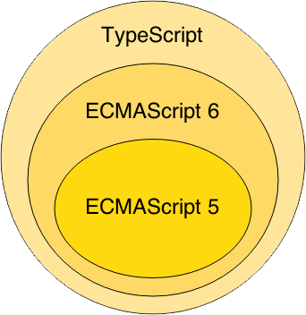
TypeScript
Notes:
Waarom TypeScript?
TypeScript is superset of ES6 en ES5.
ES = Standaard specificatie van JavaScript
ES6 = de nieuwste specificatie van Javascript, maar wordt nog niet ondersteund in alle browsers.
ES5 is de huidige standaard voor javascript en wordt ondersteund in de browsers.
TypeScript wordt vertaald naar ES5 (Middels een Transpiler).
-----------------
TypeScript is van Microsoft.
Javascript is geschreven conform ES5

Slide 4
TypeScript Class
class BookListComponent {
books: String[];
constructor() {
this.books =[‘book1’, ‘book2’]
}
}
Notes:
Example of a TypeScript class !!!
This refers to the class.

Slide 5
Component based A component adds logic to the DOM elements Angular app consist of a treestructuur of components
Index.html
AppComponent
BookSearchComponent
DashBoardComponent
BooksComponent
BookDetalsComponent
Notes:
Angular is a tree of components, because it has the same structure as your html-structure !!!
Index.html is the parent template of AppComponent ect…
AppComponent is the parent of BookComponent and …

Slide 6


Slide 7
Component based
SideBarComponent
AppModule
Module
AppComponent
BookSearchComponent
DashboardComponent
Notes:
Angular apps are composed of modules.
Modules exports classes, function, values — that other modules import.

Slide 8
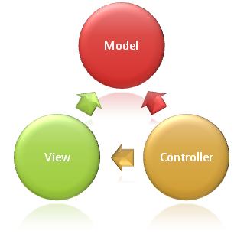
Syntax Component
import {Component} from ’@angular/core';
@Component({
selector: ‘book-list'
templateUrl: ‘booklist.template.html'
})
export class DashboardComponent {
books: string[];
constructor() {
this.books =[‘book1’, ‘book2’]
}
}
Notes:
Structuur
This class is written in Typescript!
How to convert this class in a Component:
- You import the Typescript libraries from Angular ---> a Component is imported here
- You can now convert the class in a Component with the @Component annotation
- templateUrl - the address of this component's template
How does this work in action
With the selector you can instantiate and call the component
With the CSS selector you can tell Angular to create an instance of this component where it finds a <grocery-list> tag in parent HTML.
You export the Component class so that you can import and use it in the rest of your application.

Slide 9
Selector in index.html
….
<book-list></book-list>
….
Notes:
10.34

Slide 10
Syntax template booklist.template.html
<p>Booklist: </p>
<ul>
<li *ng-for = “let book of books">
{{book}}
</li>
</ul>
Notes:
https://angular.io/docs/ts/latest/guide/template-syntax.html#!#star-template
*ng-for – Why?
The STAR Turns the li element and its contents into a template, and uses that template to instantiate a view for each item in list.

Slide 11
Module
SideBarComponent
AppModule
Module
AppComponent
BookSearchComponent
DashboardComponent
Notes:
Angular apps are composed of modules.
Modules exports classes, function, values — that other modules import.

Slide 12
AppModule = entry point App
import {NgModule} from ‘@angular/core';
import {BrowserModule} from ‘@angular/platform-browser';
import {AppComponent} from ‘./app.component';
import {BookSearchComponent} from ‘../book-search/book-search.component';
import {DashboardComponent} from ‘../dashboard/dashboard.component';
@NgModule({
imports: [BrowserModule], // inject build-in modules
declarations: [AppComponent , BookSearchComponent, DashboardComponent], // inject your own components
bootstrap: [AppComponent] // main component you need to bootstrap
})
export class AppModule { }
Notes:
AppModule is the main entrypoint of your application = root module
@NgModule: Use @NgModule to Manage Dependencies in your Angular 2 Apps
Since we declared the BookSearchComponent in our root module, we can now use this BookSearchComponent anywhere in our application without needing to declare or import it again. In essence, the @NgModule handles dependency injection for us, so any component we declare will have the inherent knowledge of our other dependencies. We are not limited to declaring only components here, we could additionally write a directive or service, and declare use it the exact same way.
Imports: for importing build-in modules example BrowserModule for using: *ng-for
Declarations: for injecting your own components
Bootstrap: you need to bootstrap your main component

Slide 14


Slide 15


Slide 16
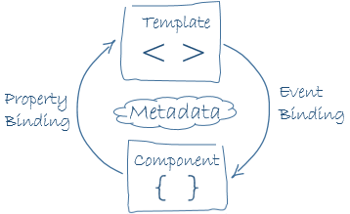
Data binding
Notes:
Databinding = Data binding in AngularJS is the synchronization between the model and the view.

Slide 17
Data binding
<div>{{book.title}}</div>
<input value=“text” [disabled]=“isDisabled”></input>
<div (click)="selectBook($event)></div>
<input [(ngModel)]=“searchTermBook" >
Notes:
1. To render a value in the view → interpolation
2. To resolve and bind a variable to a component-property
3. Calls method selectBook when a click event is triggered on this button element (or its children) and passes in the event object.
4. Two way data binding is used in forms.

Slide 18
Asynchronous programming

Slide 19
Asynchronous services
Angular uses httpClient Module
In @NgModule → import { HttpClientModule } from '@angular/common/http';
Observable

Slide 20
Observable
Notes:
You are a Observer = Listener and Subscriber on the data
TV is the Observable = Provider of Async data

Slide 21
Observable
Returns a stream of values over time

Slide 22
Observable
Cancelable
Returns a stream of values over time
Lazy
Subscribe to the stream (push mechanism)
Array-methods on stream → map(), filter(), reduce()
Notes:
Lazy: er gebeurt niks met de ontvangen stream, totdat hij aangeroepen wordt
Observable is te vergelijken met een array, die langzamerhand gevuld wordt met data.
Omdat een observable zich gedraagd als een array, zijn allerlei array methods beschikbaar, zoals: map(), filter(), reduce()
Example stream: list of ’share prices’ which changes each minute.

Slide 23


Slide 24
Interactive diagrams of Rx Observables
http://rxmarbles.com/
RXFiddle.net

Slide 25
Observable syntax
let source = Rx.Observable
.firstOperator()
.moreOperators() (→ map(), reduce())
let result = source.subscribe(x => console.log(x))
Notes:
Subscribe always on the incoming data-stream !!! (= PUSH BERICHT)
Use ES6 arrow functions

Slide 26
BookService with Observable
import { Injectable } from '@angular/core’;
import { HttpClient, HttpHeaders } from '@angular/common/http'; import { Observable } from 'rxjs/Observable';
import { catchError, map, tap } from 'rxjs/operators'; import { Book } from './book';
@Injectable()
export class BookService {
private booksUrl = 'api/books'; // URL to web api
constructor(private http: HttpClient) { }
getBooks (): Observable<Book[]> {
return this.http.get<Book[]>(this.booksUrl)
.pipe(
tap(books => this.log(`fetched books`)),
catchError(this.handleError('getBooks', []))
);
}
…..
}
Notes:
You export the AppService class so that you can import it into the application that you just created.
Use @Injectable →???
Use Observable!!!

Slide 27
Use the BookService in your BooksComponent
import { Component, OnInit } from '@angular/core'; import { Book } from '../book';
import { BookService } from '../book.service';
@Component({
selector: 'app-books',
templateUrl: './books.component.html',
styleUrls: ['./books.component.css']
})
export class BooksComponent implements OnInit {
…

Slide 28
Inject BookService via the constructor
export class BooksComponent implements OnInit {
books: Book[];
constructor(private bookService: BookService) { }
ngOnInit() {
this.getBooks();
}
getBooks(): void {
this.bookService.getBooks()
.subscribe(books => this.books = books);
}
Notes:
Subscribe/abonneer op de te ontvangen data !!!

Slide 29
Dependency Injection
implements
depends on
Service
Interface
Service
Implementatie
Component
Notes:
Alternatief voor $Scope = DI !!!

Slide 30
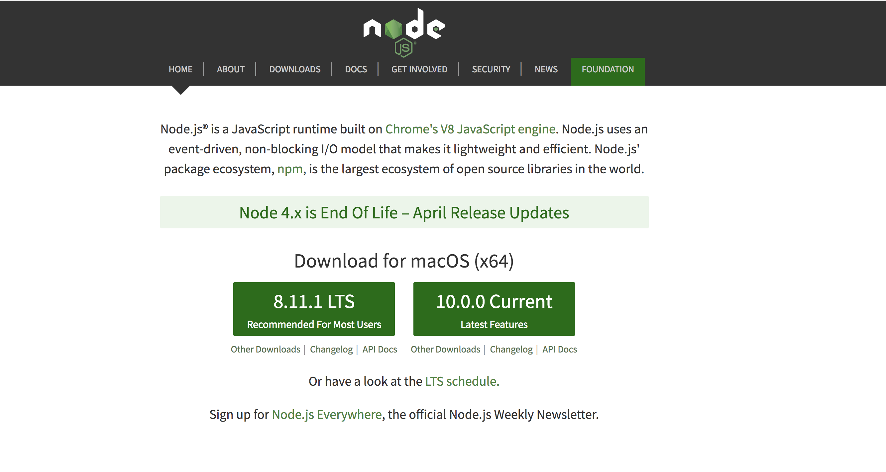
Install Node

Slide 31
IDE

Slide 32
Getting started
Download: https://github.com/petereijgermans11/workshop-reactjs-angular
Bootstrap your application: cd ./angular
npm install -g @angular/cli
npm install
ng serve --open
!oops
This application doesn't work :(
See tutorial to fix the problems: https://angular.io/tutorial/toh-pt6

